Slide 1
CPDD 78th Annual Scientific Meeting 2016 Travel Award Recipients

Slide 2
Congratulations to the 2016 CPDD Early Career Investigator Awardees!

Slide 3
Sean Allen, DrPh, MPH
Johns Hopkins University

Slide 4
Seth Batten, MS
University of Kentucky

Slide 5
Kelly Courtney, MA
UCLA

Slide 6
Anita Cservenka, PhD
UCLA

Slide 7
Rachel Denlinger, MPH
Brown University

Slide 8
Mehdi Farokhina, MD
NIH Intramural Program

Slide 9
Danielle Horyniak, PhD
UCSD

Slide 10
Bradley Kerridge, PhD
Columbia University

Slide 11
Allison Kurti, PhD
University of Vermont

Slide 12
Rebecca McDonald, MSc
King’s College

Slide 13
Irene Pericot-Valverde, MA
University of Oviedo

Slide 14
Paul Regier, PhD
University of Pennsylvania

Slide 15
Michael Regner, MD
University of Colorado Denver

Slide 16
Glenn-Milo Santos, PhD, MPH
UCSF

Slide 17
Roman Shrestha, MPH
University of Connecticut

Slide 18
Fred Arne Thorberg, PhD
University of Oslo

Slide 19
Denise Vidot, PhD
University of Miami

Slide 20
Christine Vinci, PhD
University of Texas MD Anderson Cancer Center

Slide 21
Sarah W. Yip, MSc, PhD
Yale University

Slide 22
Yafang Zhang, BS
University of Texas Medical Branch

Slide 23
Congratulations to the 2016 Stephen G. Holtzman Travel Award Recipient!

Slide 24
Jae Kim
Temple University

Slide 25
Primm-Singleton Travel Awardees 2016

Slide 26
Alexander Armendariz

Slide 27
Danni Lanaway, M.A. University of Cincinatti

Slide 28
Suky Martinez

Slide 29
Austin Nation Ph.D., RN

Slide 30
Steven Nieto

Slide 31
Daniel Peterson PhD

Slide 32
Claudia Soto

Slide 33
Yasmin Zakiniaeiz

Slide 34
2016 NIDA Director’s Travel Award Recipients

Slide 35
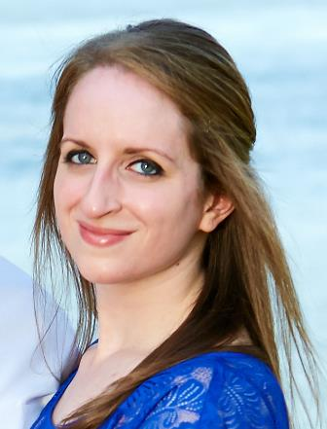
Caroline A. Arout, PhD Yale University School of Medicine

Slide 36
Jacob Borodovsky, BA Geisel School of Medicine at Dartmouth

Slide 37
Hui Cheng, PhD Michigan State University

Slide 38
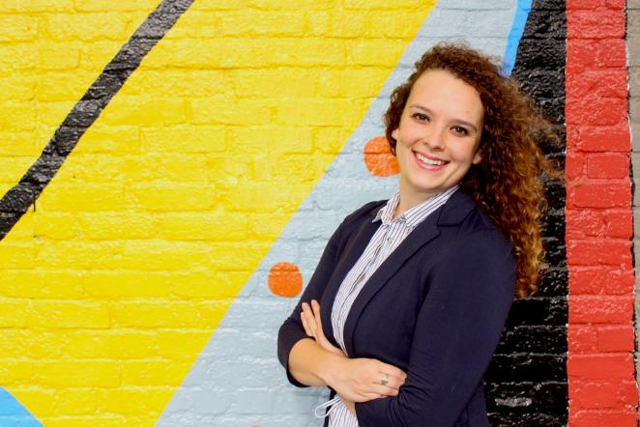
Hanna Crooke, MPH University of Florida

Slide 39
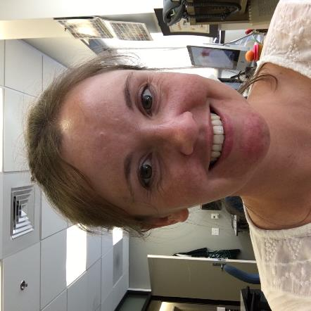
Katie Doyle, MS San Diego State University
University of California, San Diego

Slide 40
Brian J. Fairman, PhD
Johns Hopkins
Bloomberg School of Public Health

Slide 41
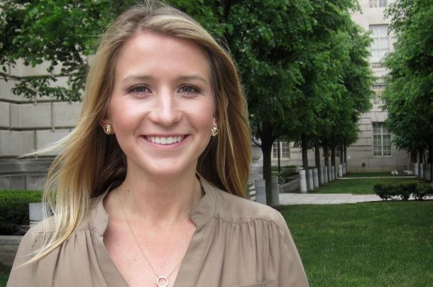
M. Claire Greene, MPH
Johns Hopkins
Bloomberg School of Public Health

Slide 42
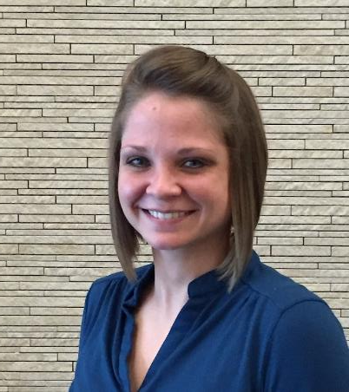
Sally Huskinson, PhD University of Mississippi Medical Center

Slide 43
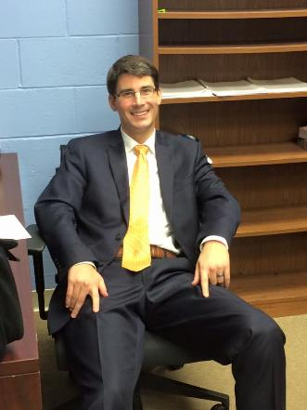
Brantley Jarvis, PhD Johns Hopkins University School of Medicine

Slide 44
Tonisha Kearney-Ramos, PhD Medical University of South Carolina

Slide 45
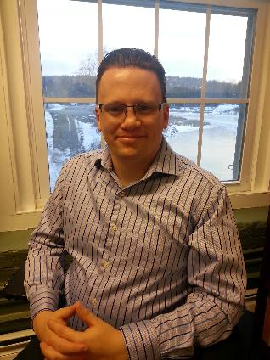
Dustin C. Lee, PhD Geisel School of Medicine at Dartmouth

Slide 46
Carlos C. Mahaffey, Pharm D, MPH University of Kentucky

Slide 47
Pia M. Mauro, PhD Columbia University
Mailman School of Public Health

Slide 48
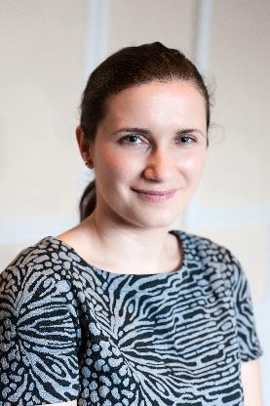
Verica Milivojevic, PhD Yale University School of Medicine

Slide 49
Rebecca Miller, BS The Scripps Research Institute/
University of Southern California

Slide 50
Matthew Rich, MS University of Pittsburgh

Slide 51
David V. Smith, PhD Rutgers University

Slide 52
Mary M. Sweeney, PhD Johns Hopkins University School of Medicine

Slide 53
Patrick D. Worhunsky, PhD Yale University School of Medicine

Slide 54
Sean X. Luo, MD/PhD Columbia University

Slide 55
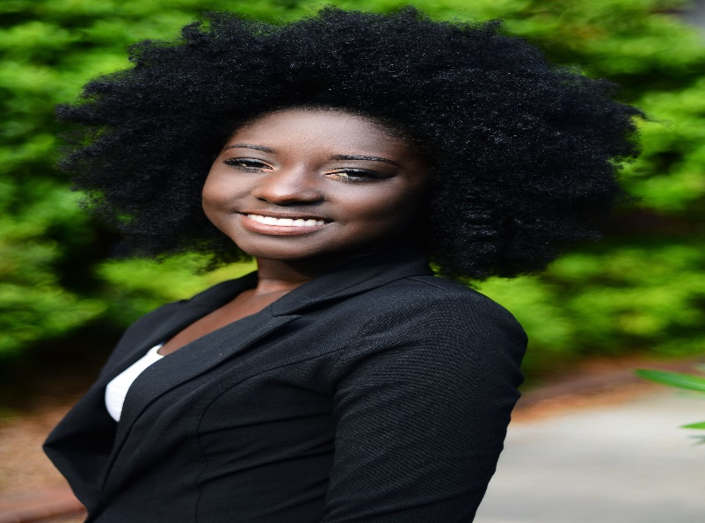
Abenaa Acheampong
University of Florida
Department of Epidemiology
NIDA Women & Sex/Gender Differences Research Junior Investigator Travel Awardee

Slide 56
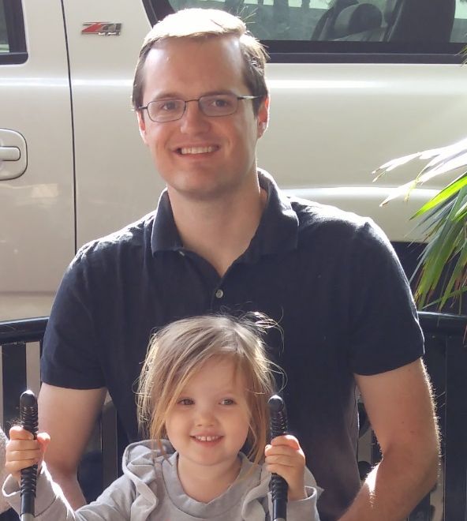
Jared Bagley
University of California,
Santa Barbara
Department of Psychological and Brain Sciences
NIDA Women & Sex/Gender Differences Research Junior Investigator Travel Awardee

Slide 57
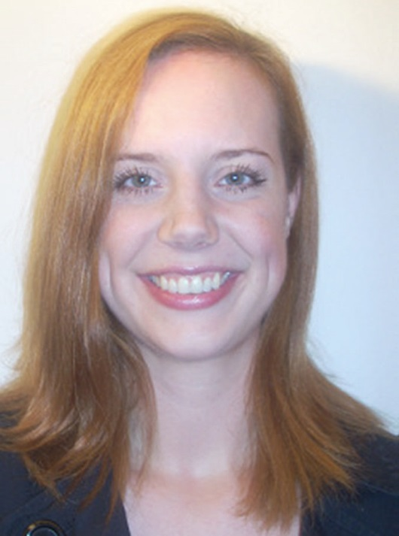
Laura Brandt
Medical University of Vienna Center for Public Health
NIDA Women & Sex/Gender Differences Research Junior Investigator Travel Awardee

Slide 58
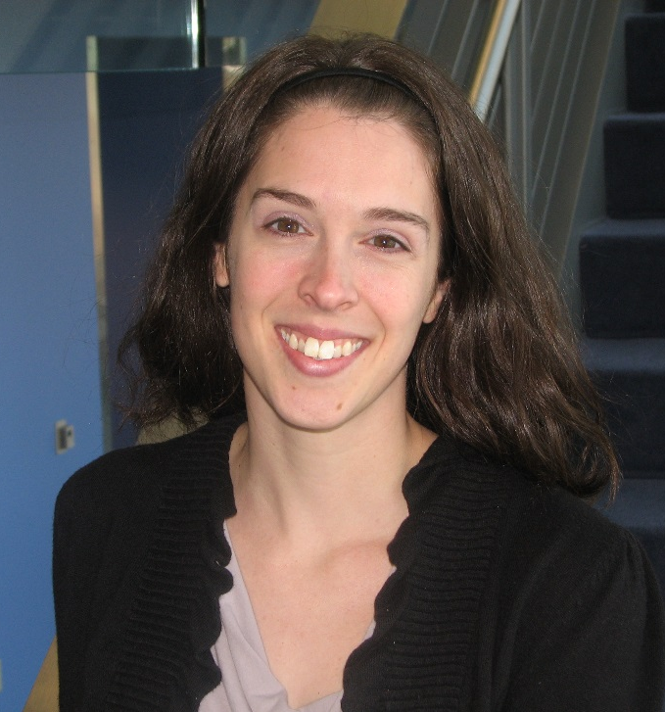
Lisa K
Brents
University of Arkansas for Medical Sciences
Psychiatric Research Institute
NIDA Women & Sex/Gender Differences Research Junior Investigator Travel Awardee

Slide 59
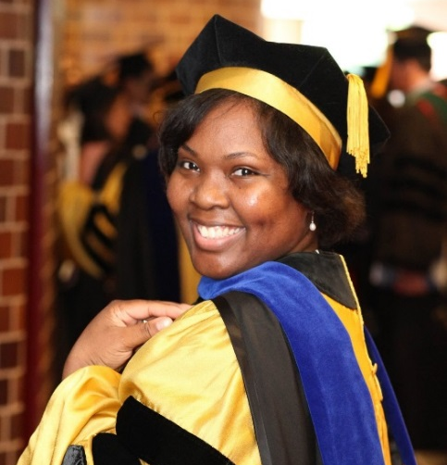
Qiana Brown
Columbia University
Department of Epidemiology
NIDA Women & Sex/Gender Differences Research Junior Investigator Travel Awardee

Slide 60
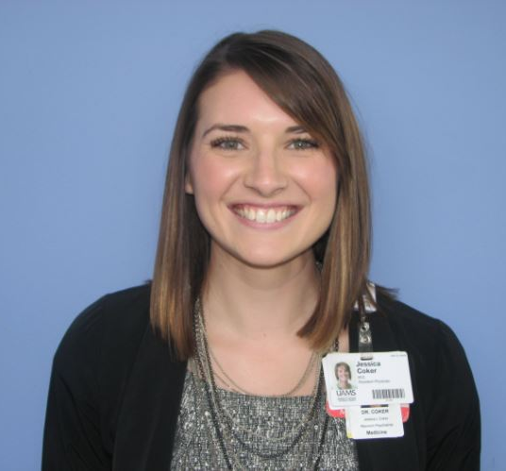
Jessica Coker
University of Arkansas for Medical Sciences
Psychiatric Research Institute
NIDA Women & Sex/Gender Differences Research Junior Investigator Travel Awardee

Slide 61
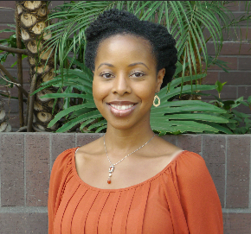
Mekeila Cook
University of California, Los Angeles
Department of Psychiatry and Biobehavioral Sciences
NIDA Women & Sex/Gender Differences Research Junior Investigator Travel Awardee

Slide 62
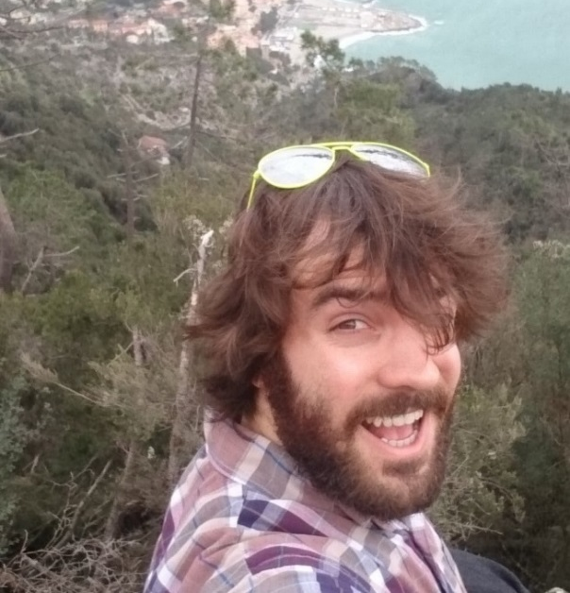
Logan Dowdle
Medical University of South Carolina
Department of Psychiatry and Behavioral Sciences
NIDA Women & Sex/Gender Differences Research Junior Investigator Travel Awardee

Slide 63
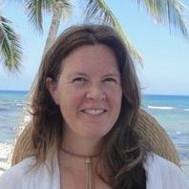
Elizabeth Evans
David Geffen School of Medicine at UCLA
Semel Institute for Neuroscience and Human Behavior
NIDA Women & Sex/Gender Differences Research Junior Investigator Travel Awardee

Slide 64
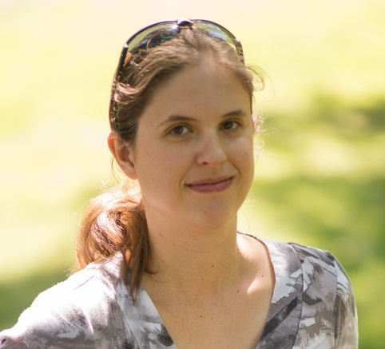
Diann Gaalema
University of Vermont
Departments of Psychiatry and Psychology
NIDA Women & Sex/Gender Differences Research Junior Investigator Travel Awardee

Slide 65
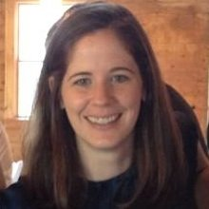
Cathryn Glanton Holzhauer
University of Massachusetts Medical School
Department of Psychiatry and Division of Addiction Psychiatry
NIDA Women & Sex/Gender Differences Research Junior Investigator Travel Awardee

Slide 66
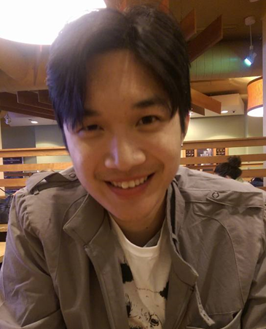
Kah-Chung Leong
Medical University of South Carolina
Department of Neurosciences
NIDA Women & Sex/Gender Differences Research Junior Investigator Travel Awardee

Slide 67
Jamey Lister
Wayne State University
School of Social Work
Department of Psychiatry and Behavioral Neurosciences
NIDA Women & Sex/Gender Differences Research Junior Investigator Travel Awardee

Slide 68
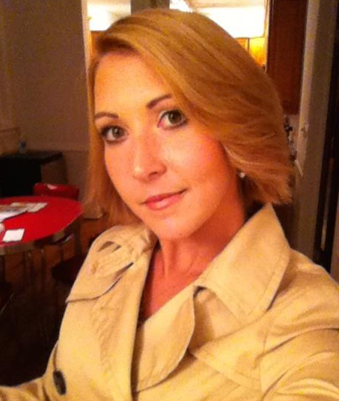
Erica McGrath
University of Texas Medical Branch
Human Pathophysiology and Translation Medicine Program
NIDA Women & Sex/Gender Differences Research Junior Investigator Travel Awardee

Slide 69
Jacquelyn Meyers
The State University of New York
Henri Begleiter Neurodynamics Laboratory
NIDA Women & Sex/Gender Differences Research Junior Investigator Travel Awardee

Slide 70
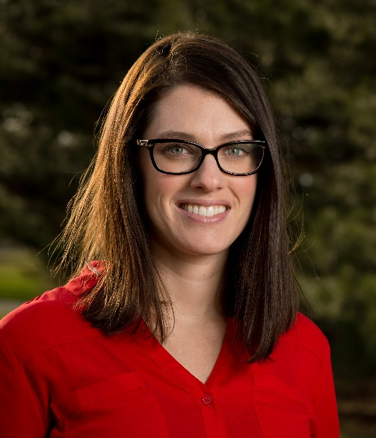
Maria Parker
Michigan State University
Department of Epidemiology and Biostatistics
NIDA Women & Sex/Gender Differences Research Junior Investigator Travel Awardee

Slide 71
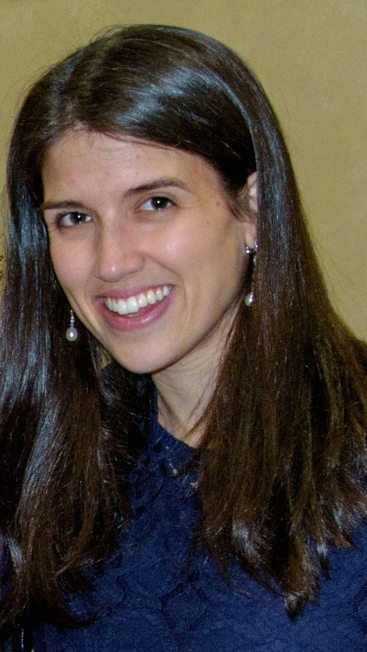
Deena Peyser
Rutgers University
Rutgers Center of Alcohol Studies
Cardiac Neuroscience Lab
NIDA Women & Sex/Gender Differences Research Junior Investigator Travel Awardee

Slide 72
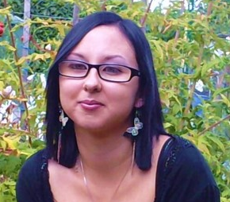
Virginie Rappeneau
Meharry Medical College
Department of Neuroscience and Pharmacology
NIDA Women & Sex/Gender Differences Research Junior Investigator Travel Awardee

Slide 73
Katherine Serafine
University of Texas at El Paso
Department of Psychology
NIDA Women & Sex/Gender Differences Research Junior Investigator Travel Awardee

Slide 74
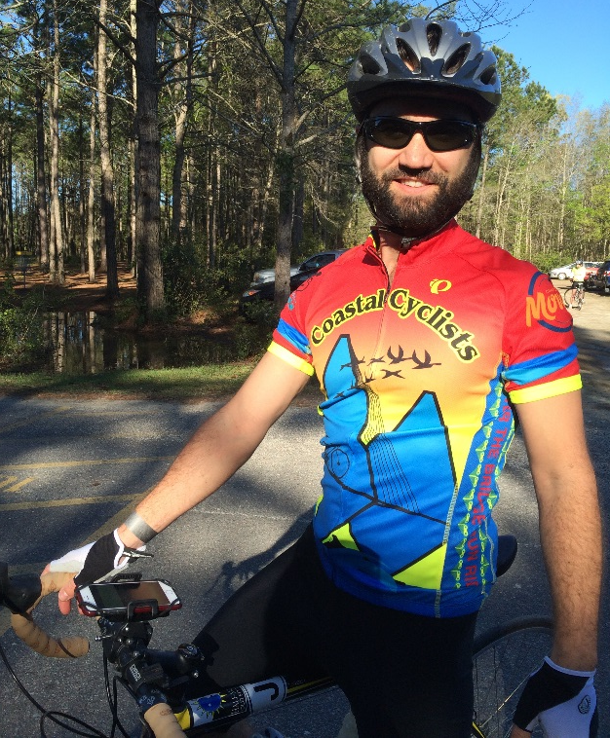
Brian Sherman
Medical University of South Carolina
Department of Psychiatry and Behavioral Sciences
NIDA Women & Sex/Gender Differences Research Junior Investigator Travel Awardee

